Slide 1
Data Science CSCI 3320
Project : AI-ML Salaries
Name : Saja Herez ID:220201405

Slide 2
About The Domain

Slide 3
The business domain of ML/AL is a highly competitive and rapidly evolving field. With the emergence of new technologies, businesses are increasingly looking for professionals with these skills to help them stay ahead in their respective markets.
Many large organizations have dedicated teams of ML/AL experts who work together on projects ranging from predictive analytics to natural language processing applications
Salaries in this domain are highly competitive, with top-tier positions commanding six-figure salaries.
With the right skillset, there is no limit as to what an individual could earn in this industry

Slide 4
Companies are willing to pay premium wages for skilled machine learning engineers who can develop complex algorithms that can improve their products or services.
Companies often struggle to determine the appropriate salary for their employees.
This is because there are many factors to consider, such as experience and qualifications, market trends and cost of living in the area.

Slide 5
About The Data

Slide 6
The data set is sourced from real-world surveys conducted by leading industry organizations such as the World Economic Forum (WEF), McKinsey & Company and Kaggle.
The data set of ML and AL salaries is an analysis of the current market trends for Machine Learning (ML) and Artificial Intelligence (AI) roles.

Slide 7
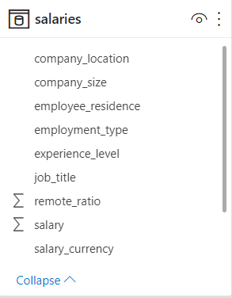
It provides insights into salary ranges across different geographies, job titles, experience levels, industries and other factors that can impact compensation packages.
The context provided by this dataset can be used to inform hiring decisions and help organizations better understand their competitive environment when recruiting top talent in ML & AI disciplines.

Slide 8
Data Exploration

Slide 9
This data set consists of 1195 rows and 11 columns.
The data set of ML and AL salaries is complete, with no missing values.
This ensures that the results are reliable, accurate, and can be used to make informed decisions about salary levels for both Machine Learning and Artificial Intelligence professionals.
Furthermore, having a complete dataset allows for more thorough analysis of trends in salary levels across different industries.

Slide 10
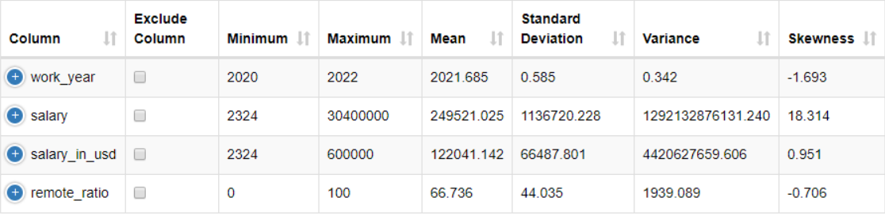
DescriptiveStatistics

Slide 11
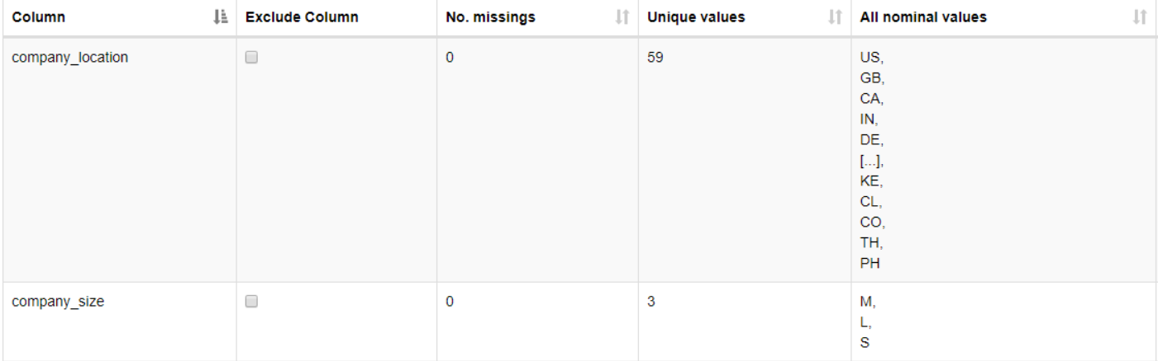
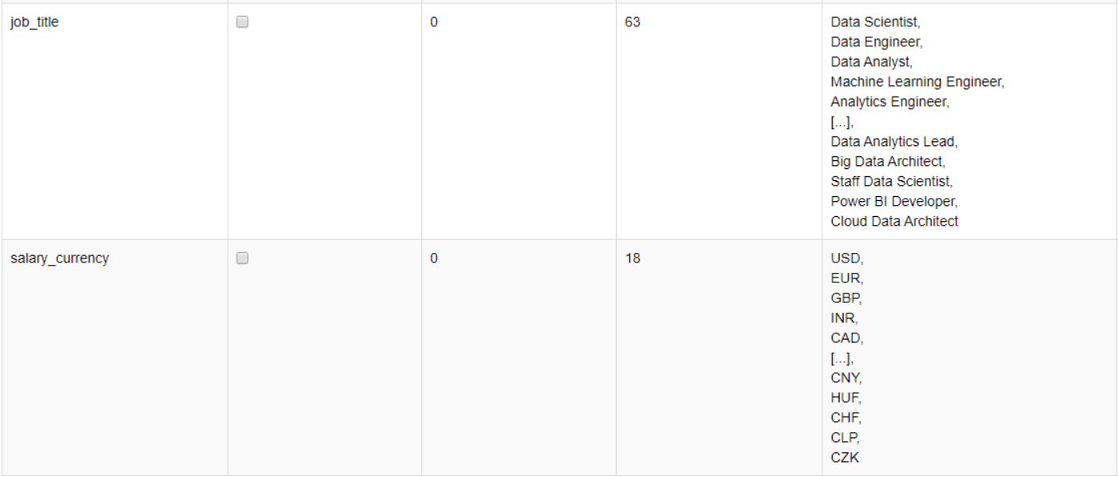

Slide 12
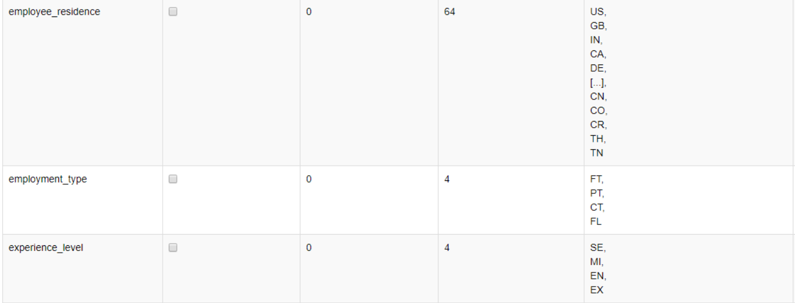

Slide 13
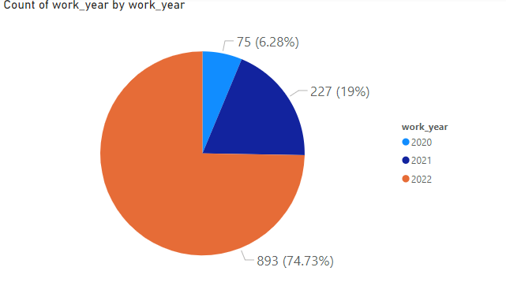
﻿2022 had the highest Count of work_year at 893, followed by 2021 at 227 and 2020 at 75.﻿﻿ ﻿﻿2022 accounted for 74.73% of Count of work_year

Slide 14
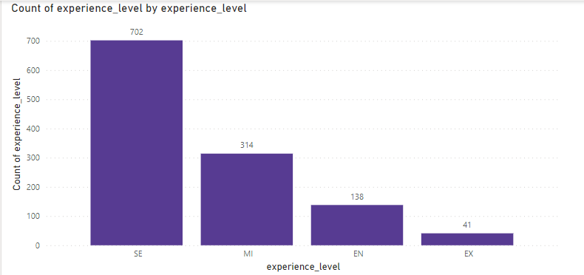
SE had the highest Count of experience_level higher than EX, which had the lowest Count of experience_level at 41.﻿﻿
﻿﻿SE had the highest Count of experience_level at 702, followed by MI, EN, and EX.﻿﻿
﻿﻿SE accounted for 58.74% of Count of experience_level.﻿﻿ ﻿﻿

Slide 15
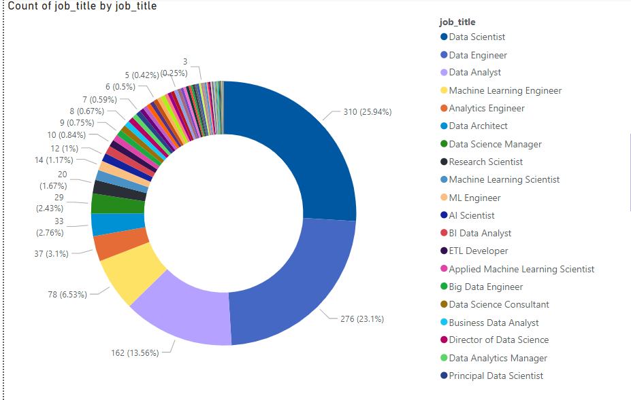
Count of job_title was highest for Data Scientist at 310, followed by Data Engineer and Data Analyst.
Data Scientist accounted for 25.94% of Count of job_title.

Slide 16
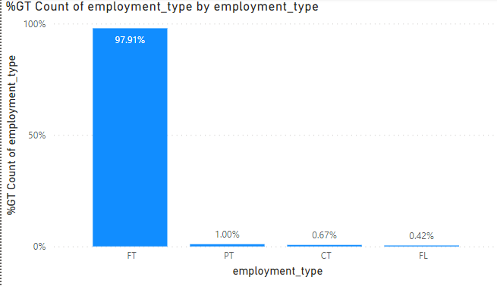
FT had the highest Count of employment_type .
FT had the highest Count of employment_type followed by PT, CT,and FL.﻿﻿
FT accounted for 97.91% of Count of employment_type .

Slide 17
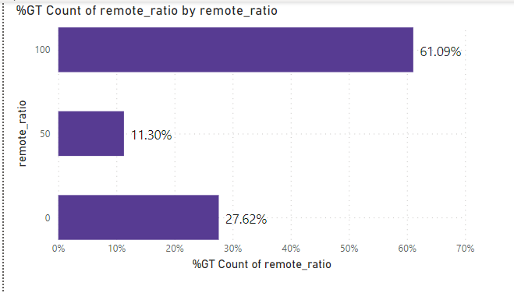
Fully remote (100) had the highest Count of remote_ratio work
Fully remote had the highest Count of employment_type followed by ,
No remote work(0) and Partially remote(50).﻿﻿
Fully remoteaccounted for 61.09% of Count of remote_ratio work.

Slide 18
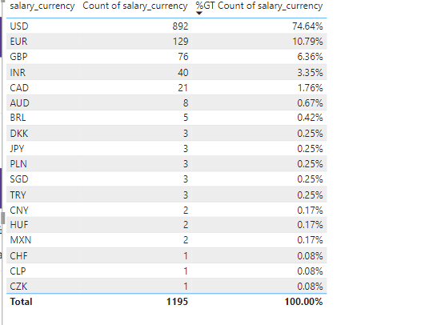
USD had the highest Count of salary_currency
followed by EUR,GBR
USD accounted for 74.64% of Count of
salary_currency .

Slide 19
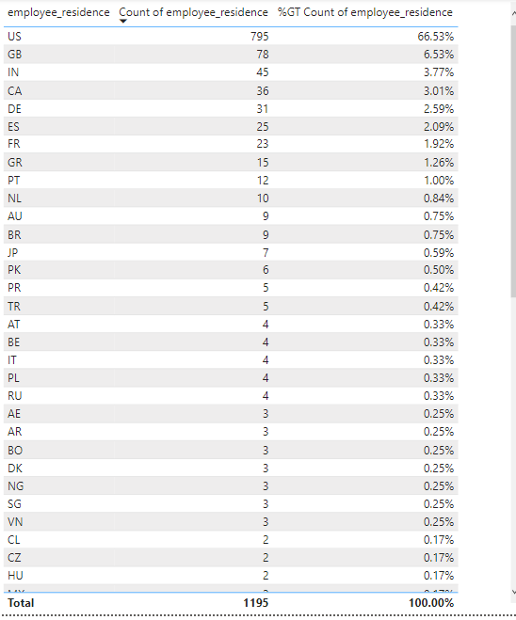
US had the highest Count of empolyee residence
followed by GB , IN.
US accounted for 66.53% of Count of
empolyee residence .

Slide 20
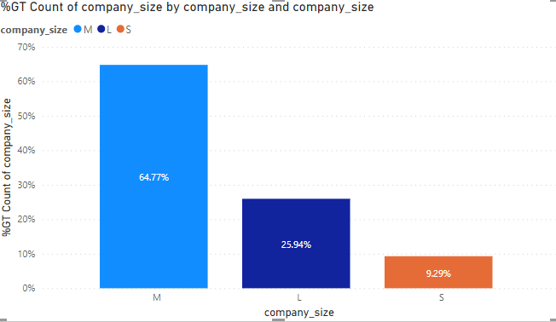
Medium company (M) had the highest Count of company size
Medium company had the highest Count of
company size followed by , Large company(L)
and small company(S).﻿﻿
Medium company accounted for 64.77% of
Count of company size.

Slide 21
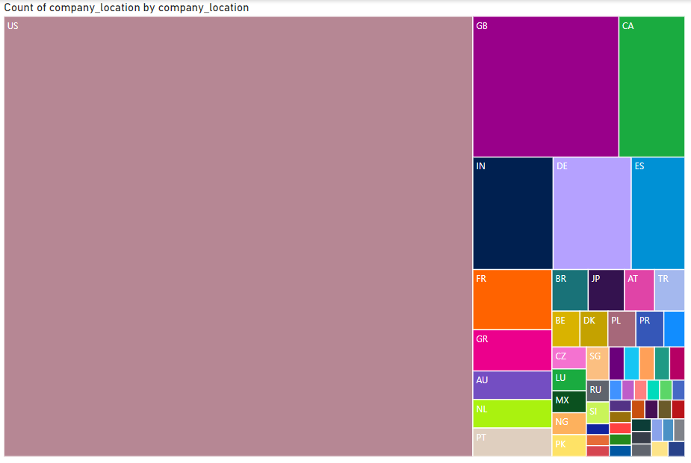
Count of company_location was highest for US at 823, followed by GB and CA.﻿﻿ ﻿﻿
﻿﻿US accounted for 68.87% of Count of company_location.

Slide 22
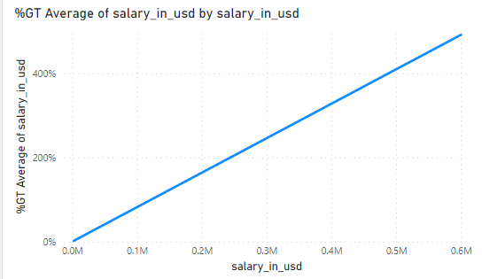
600000 had the highest Average of salary_in_usd and was 25 ,717.56% higher than 2324, which had the lowest Average of salary_in_usd at 2,324.00.
Average of salary_in_usd ranged from 2,324.00 to 600,000.00.

Slide 23
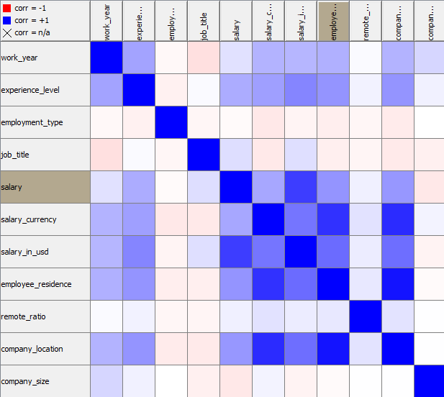
Correlation Between Attributes:

Slide 24
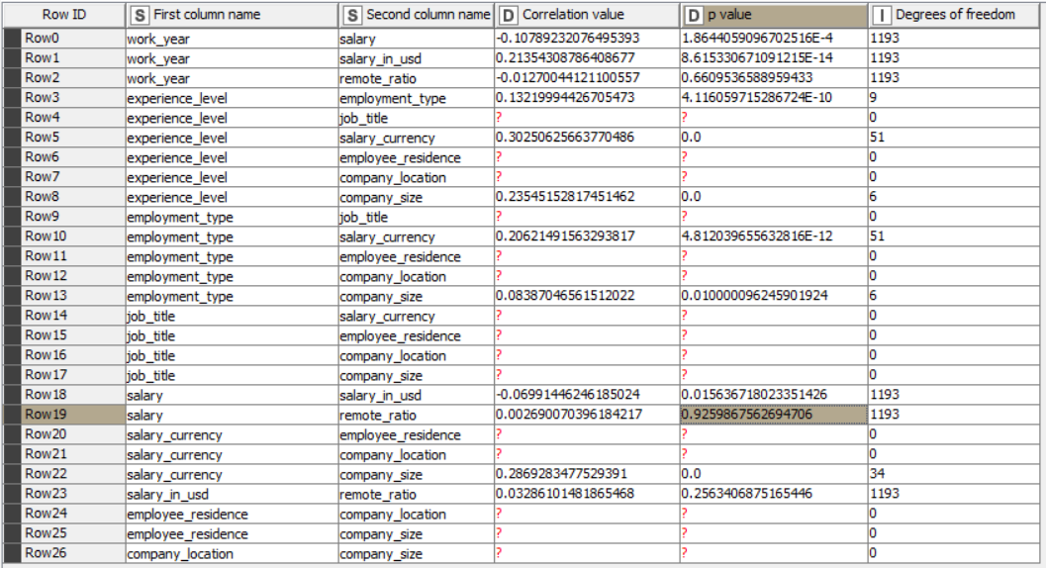

Slide 25
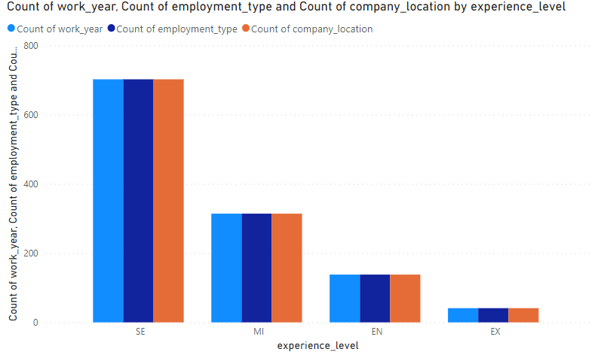
At 702, SE had the highest Count of work_year and higher than EX, which had the lowest Count of work_year at 41.﻿﻿ ﻿﻿
﻿﻿Count of work_year and total Count of employment_type are positively correlated with each other.﻿﻿ ﻿
Count of employment_type and total Count of company_location are negatively correlated with each other.
Count of work_year and total Count of company_location are positively correlated with each other.
﻿﻿SE accounted for 58.74% of Count of work_year.﻿﻿ ﻿﻿
﻿﻿Across all 4 experience_level, Count of work_year ranged from 41 to 702, Count of employment_type ranged from 41 to 702, and Count of company_location ranged from 41 to 702.

Slide 26
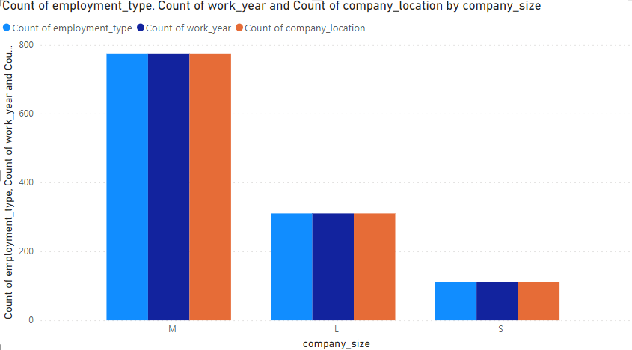
At 774, M had the highest Count of employment_type and higher than S, which had the lowest Count of employment_type at 111.﻿﻿
﻿﻿M accounted for 64.77% of Count of employment_type.﻿﻿
﻿﻿S had 111 Count of employment_type, 111 Count of work_year, and 111 Count of company_location. L had 310 Count of employment_type, 310 Count of work_year, and 310 Count of company_location. M had 774 Count of employment_type, 774 Count of work_year, and 774 Count of company_location.

Slide 27
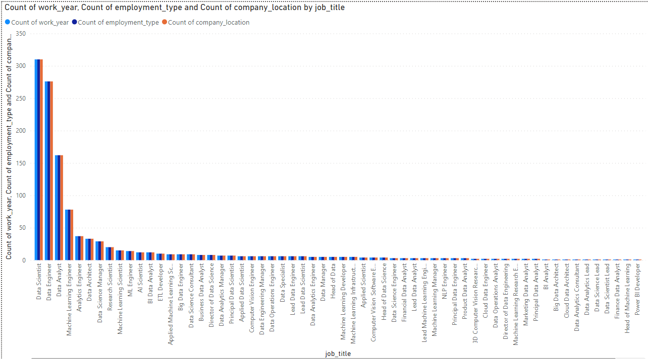
Data Scientist accounted for 25.94% of Count of work_year.f﻿﻿ollowed by Data Engineer and Data Analyst..﻿ ﻿﻿ ﻿﻿Across all 63 job_title, Count of work_year ranged from 1 to 310, Count of employment_type ranged from 1 to 310, and Count of company_location ranged from 1 to 310.

Slide 28
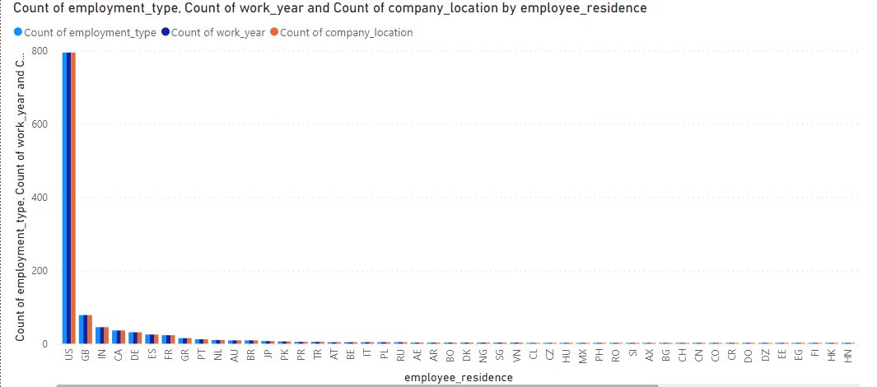
US accounted for 66.53% of Count of employment_type.﻿﻿ ﻿﻿ ﻿﻿Across all 64 employee_residence, Count of employment_type ranged from 1 to 795, Count of work_year ranged from 1 to 795, and Count of company_location ranged from 1 to 795.

Slide 29
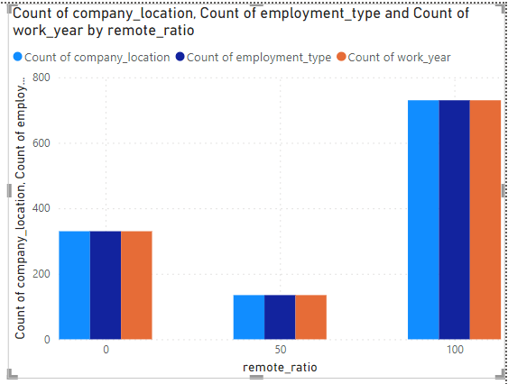
At 730, 100 had the highest Count of company_location and was 440.74% higher than 50, which had the lowest Count of company_location at 135.
﻿﻿ ﻿﻿Count of company_location and total Count of employment_type are positively correlated with each other.﻿﻿
﻿﻿100 accounted for 61.09% of Count of company_location.﻿﻿
﻿﻿100 had 730 Count of company_location, 730 Count of employment_type, and 730 Count of work_year. 50 had 135 Count of company_location, 135 Count of employment_type, and 135 Count of work_year. 0 had 330 Count of company_location, 330 Count of employment_type, and 330 Count of work_year.

Slide 30
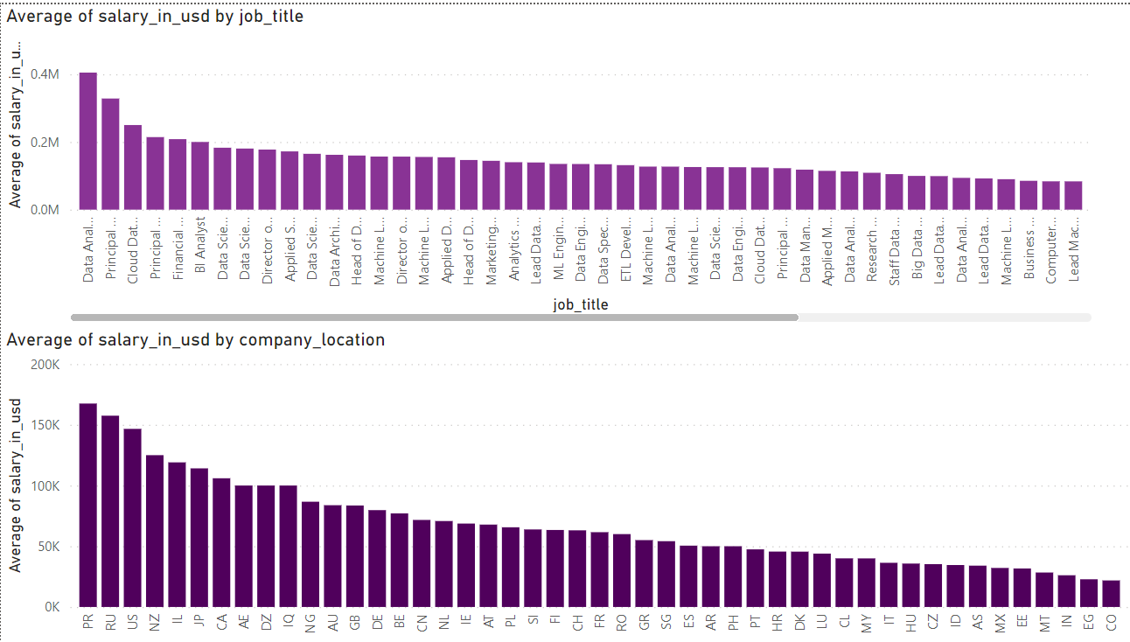

Slide 31
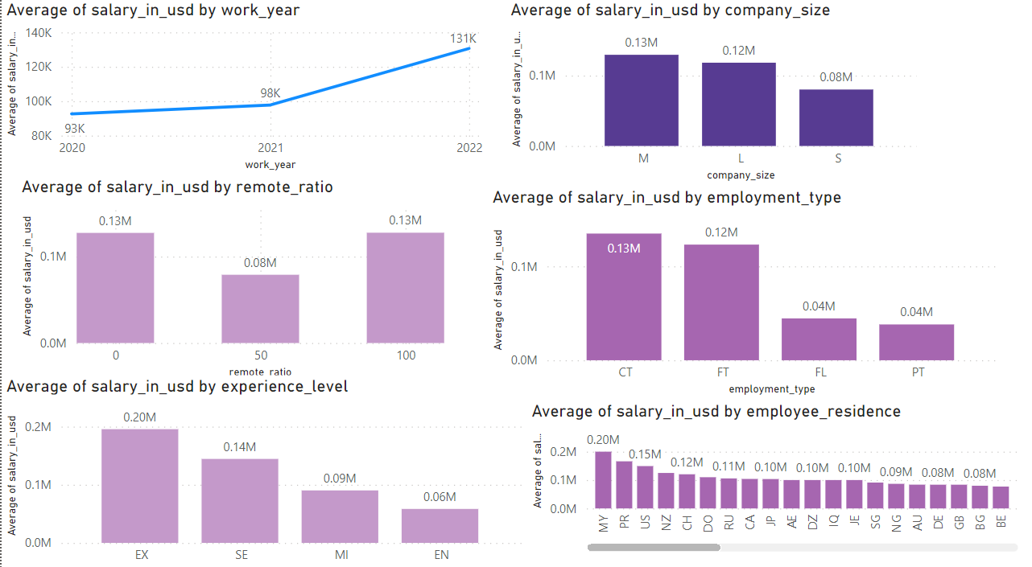

Slide 32
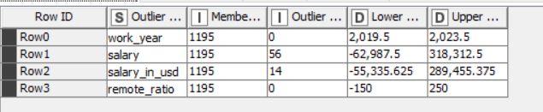
Show Outlier :
The analysis of the salary-in-usd column revealed 14 outliers in the dataset.
These outliers represent a small fraction of the total data set, but they are important to take into consideration when making decisions based on this information.
It is essential to investigate these outlier values further to ensure that their inclusion does not skew results or lead to incorrect conclusions.

Slide 33
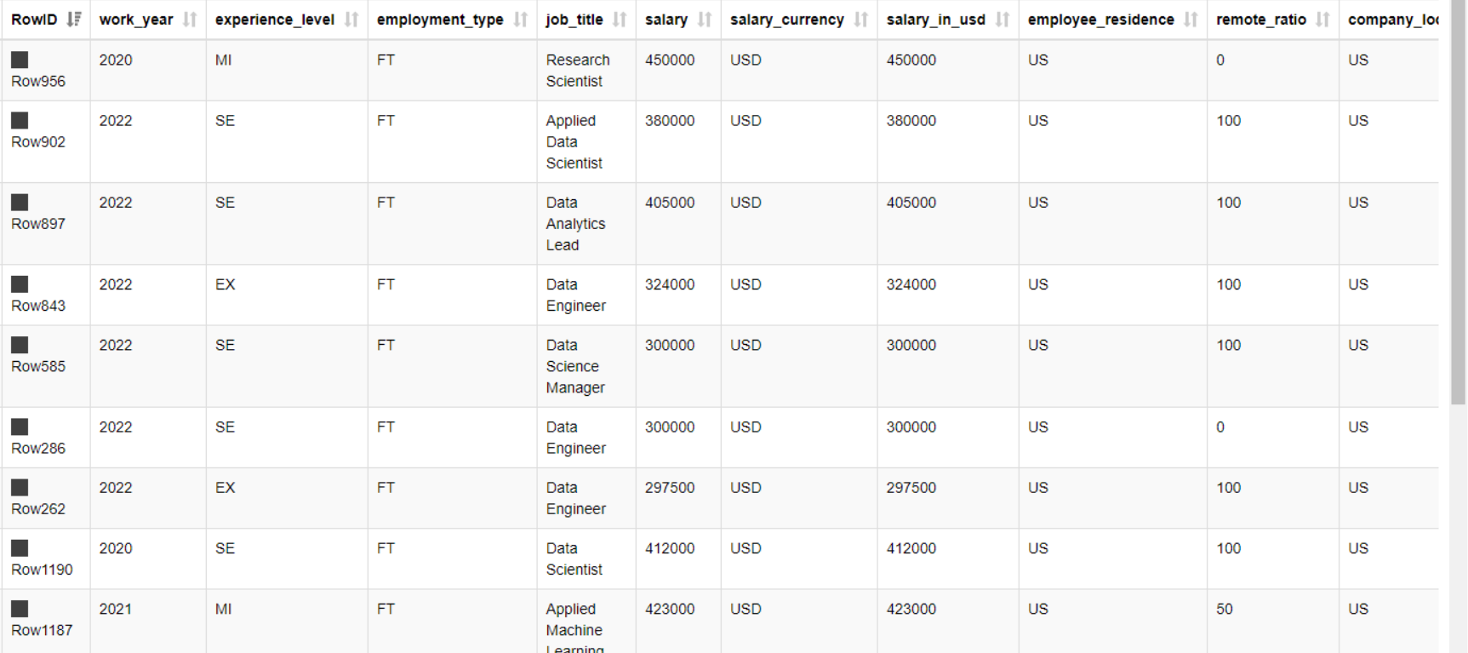
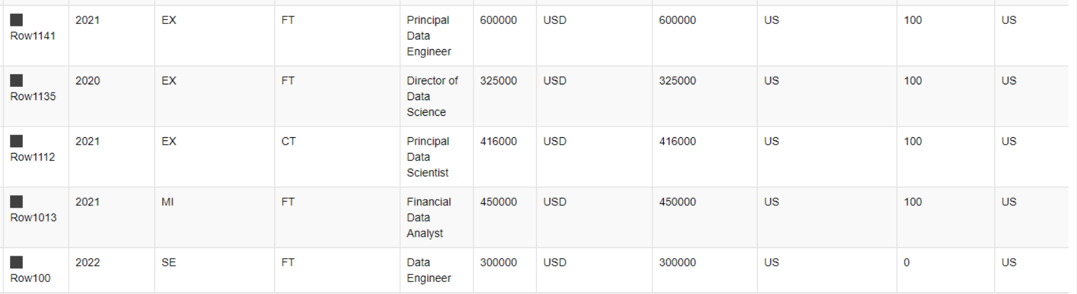

Slide 34
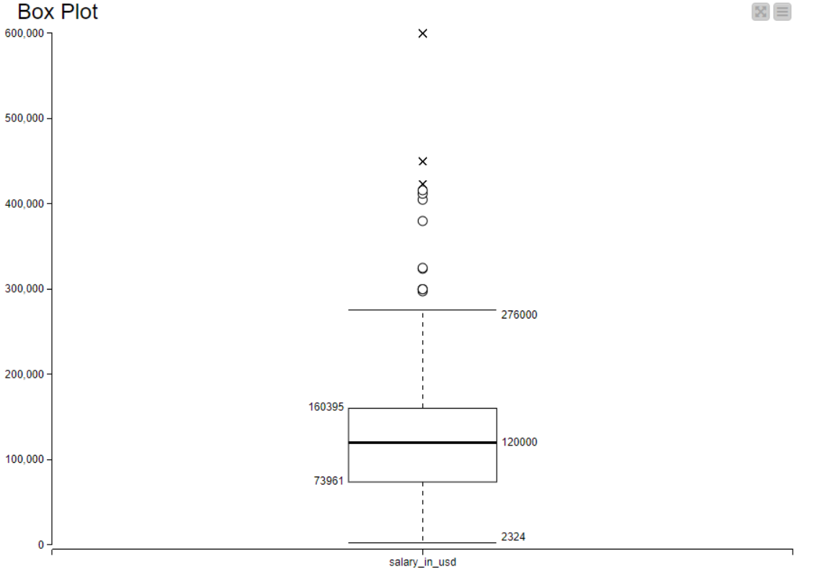
Visualize Outlier:

Slide 35
Data Exploration

Slide 36
Data Cleaing:
Identify and reduce noise (outliers)in the data .Then remove the row that included outliers .
Because we have just 14 outlier in the dataset.
Try to find missing values , but the on missing data.
Try to find erroneous data , but the on errors .
Remove the duplicated rows . Remove 224 rows

Slide 37
Data transformation :
Add experince level attribute of type number depend on the value of experince level :
$experience_level$ = "EN" => 1 $experience_level$ = "MI" => 2 $experience_level$ = "SE" => 3 $experience_level$ = "EX" => 4
Add employment type attribute of type number depend on value of employment_type :
$employment_type$ = "PT" => 1 $employment_type$ = "FT" => 2 $employment_type$ = "CT" => 3 $employment_type$ = "FL" => 4

Slide 38
Add company_size attribute of type number depend on
value of company_size :
$company_size$ = "S" => 1 $company_size$ = "M" => 2 $company_size$ = "L" => 3
By useing column filter node we exclude the categorical attributes( company_size , experince level , employment_type ) becuase we replace them be numerical values.

Slide 39
Filtering row by the company location attributes by values of (US , GB).it the most frequent values .
normalizes the values of all (numeric) columns.

Slide 40
Data Split:
doing the partition of data set by stratified sampling based on job title .
Part | Number of rows | %
Train | 679 | 70%
Test | 292 | 30%

Slide 41
Descriptive analytics

Slide 42
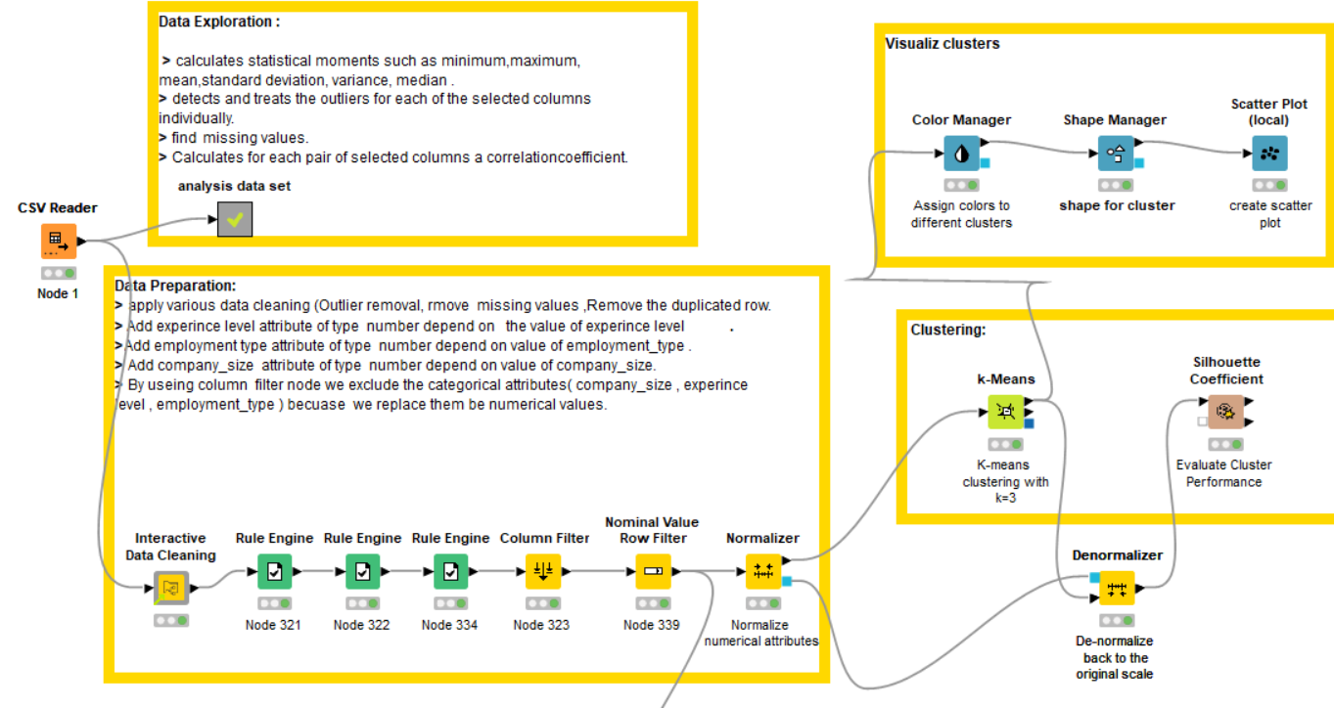
Clustering:

Slide 43
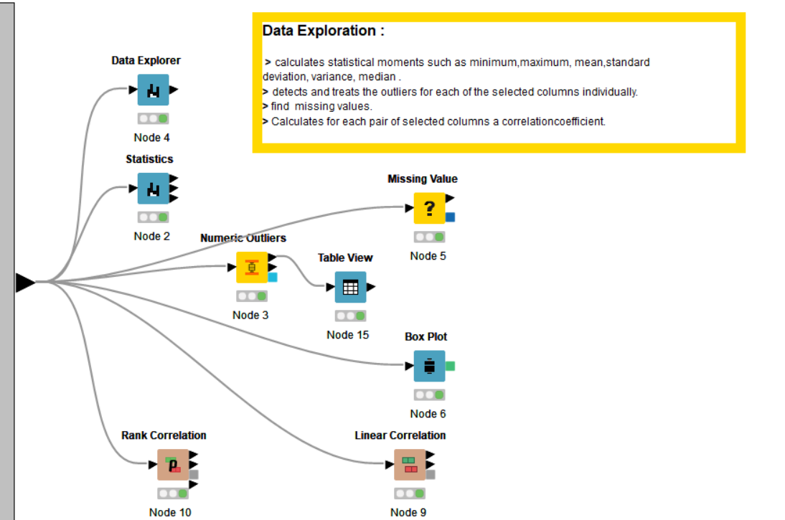

Slide 44
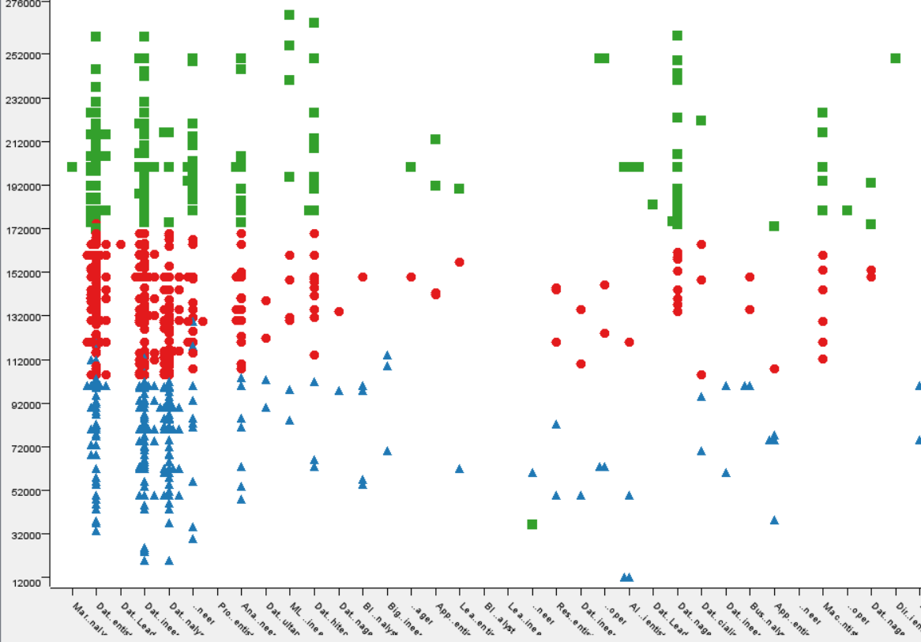
Apply the k means algorithm on data set to make clustering .
We try to use several number of cluster on the data set (3,4,5,7,8).
The image display the final suitable number of clusters (K=3).
Visualize the clusters according to (salary_in_usd)and (job_title).

Slide 45
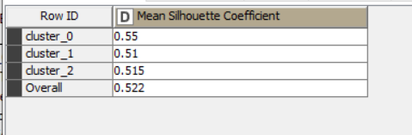
Evaluate resualt:
We try to use several number of cluster on the data set (3,4,5,7,8).
Then , make the evaluation by using Silhouette Coefficient node
The Silhouette Coefficient is a useful metric for evaluating clustering performance.
the higher the score, the better
3 cluster ->0,52 , 4cluster ->0,493 ,5cluster ->0,50 ,6cluster ->.505 ,7 clusters ->0,491
The (k=3 ) have the higher value so we use it .

Slide 46
Predictive analytics

Slide 47
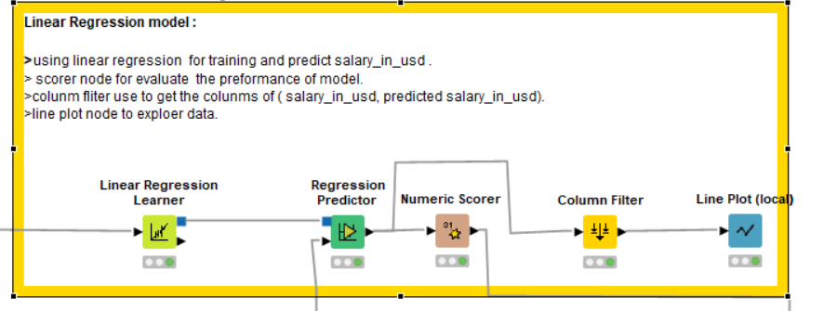

Slide 48
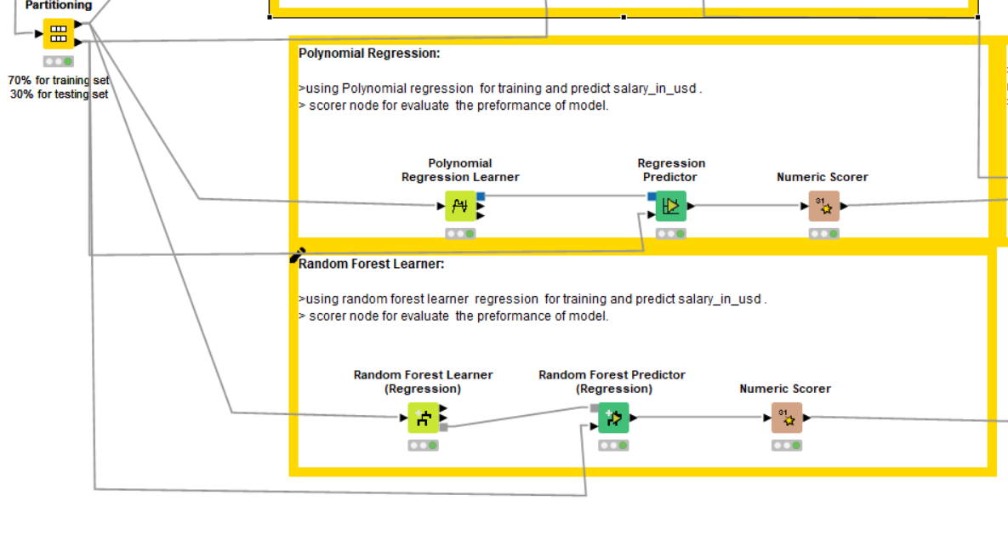

Slide 49
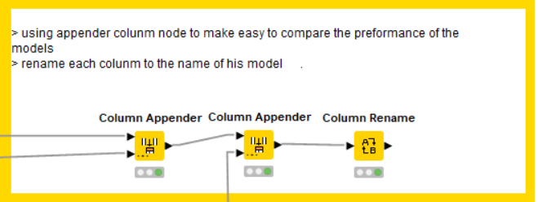

Slide 50
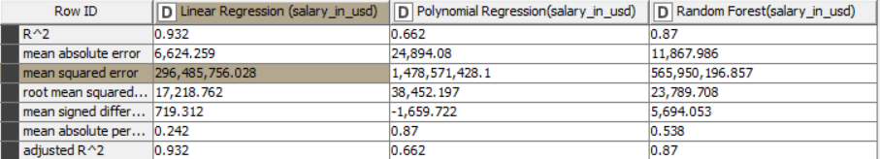
ML Result:
After using different ML models (linear regression , polynomial Regression , Random Forest) to predicte the taget(salary_in_usd) , the suitable model is linear regression .
Because it have higher value of R^2 which is .932 and low value of mean squared error.

Slide 51
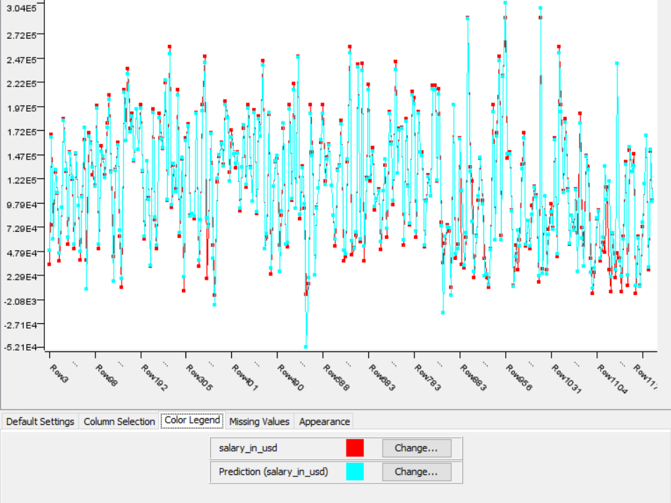
Exploering the target(salar_in_usd) and prediction(salary_in_usd) .
The value of accuracy 93%.

